Slide 1
Wireless-Enabled Smart-Lights Hub Prototype Senior Design December 2019 Team 16 http://sddec19-16.sd.ece.iastate.edu/
Dr. Manimaran Govindarasu
Dr. Ravikumar Gelli
Alexander Beaver
Ryan Bush
Aaron Ramsey
Logan Zasada

Slide 2
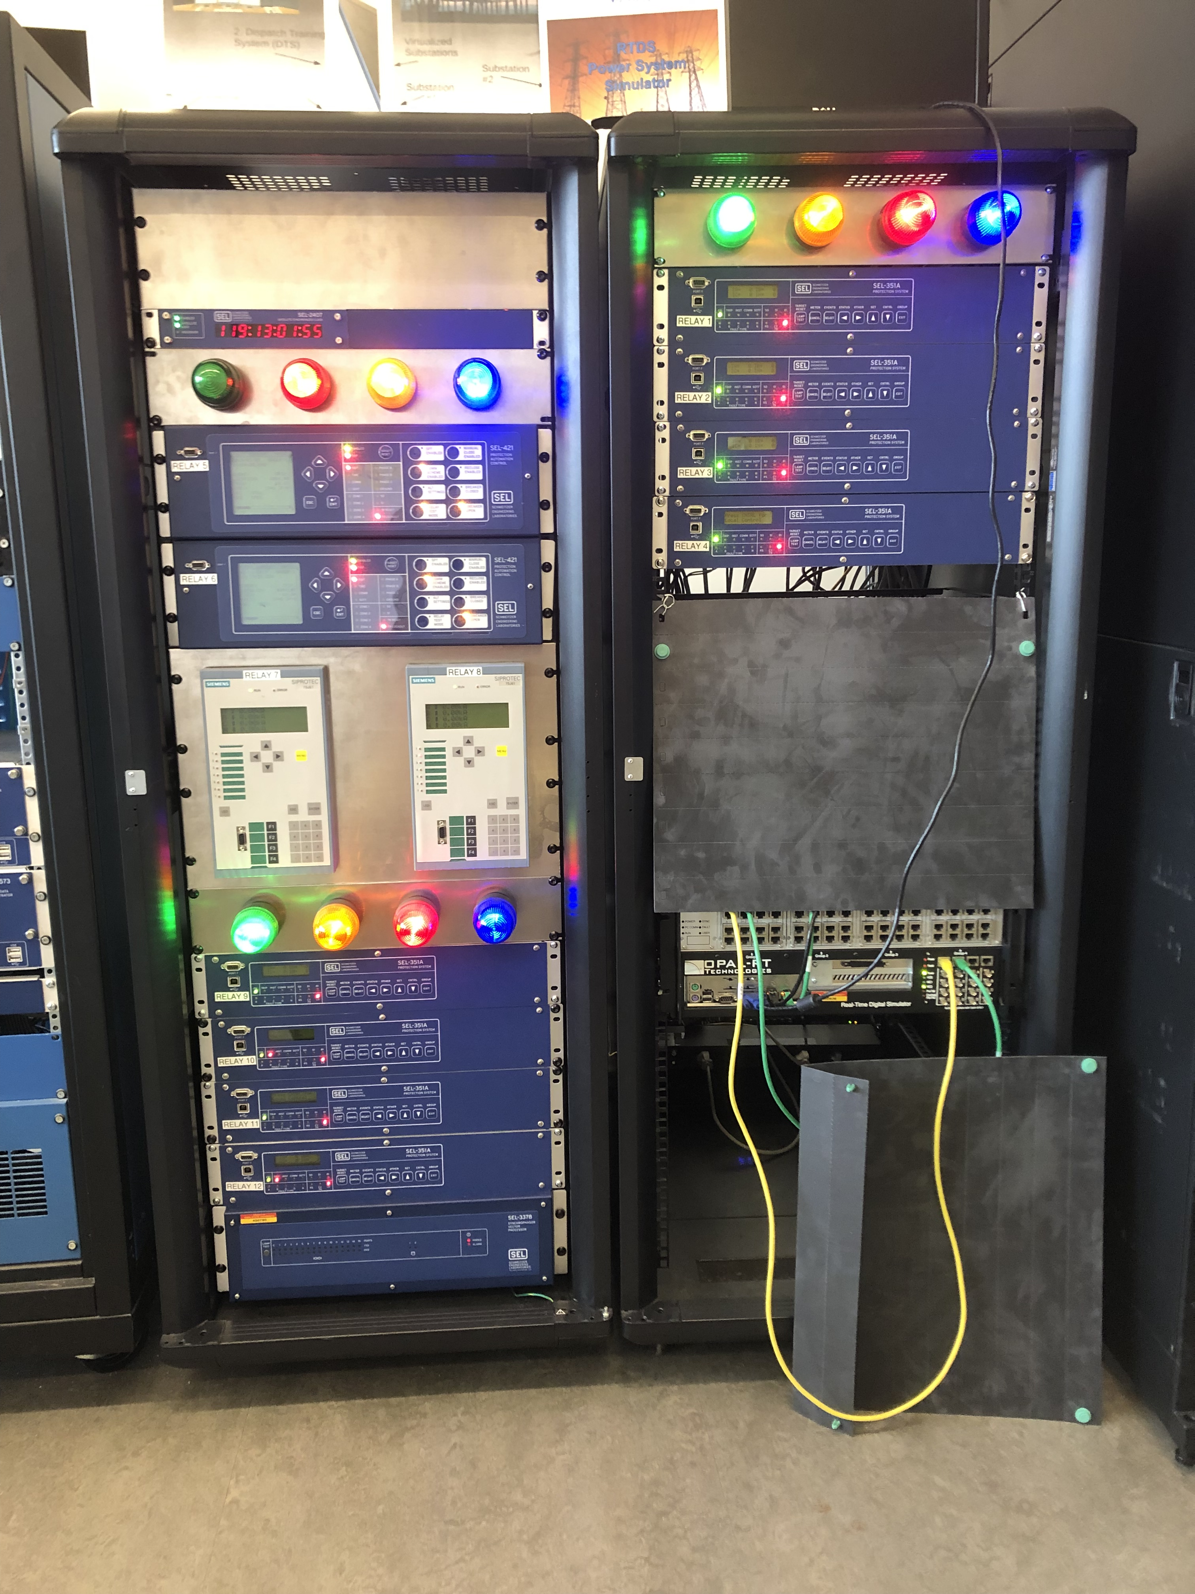
The Problem
Light system in PowerCyber lab cannot represent large simulated power networks.
Create a system that can handle more network components and be portable.
Current system cannot move out of the lab.
Lack of portability means less outreach opportunity.

Slide 3
Functional Requirements
Accept input from 100 Simulation Components
Output to 100 IOT lights
Capability to map relay inputs to light outputs via UI
IOT lights should be magnetically mountable
IOT lights should be able to operate continuously for 8 hours
IOT lights should come in at least 4 different colors
IOT lights must be operated wirelessly
System should be capable of charging at least 8 lights at once

Slide 4
Non-Functional Requirements
System should be easy to move through standard door frames
Magnetic mounting board should not obscure any image projected onto it
Light status should update in less than a second when corresponding relay is updated
Relay interface components should be easy to connect
IOT lights should be similar in size to existing solution

Slide 5
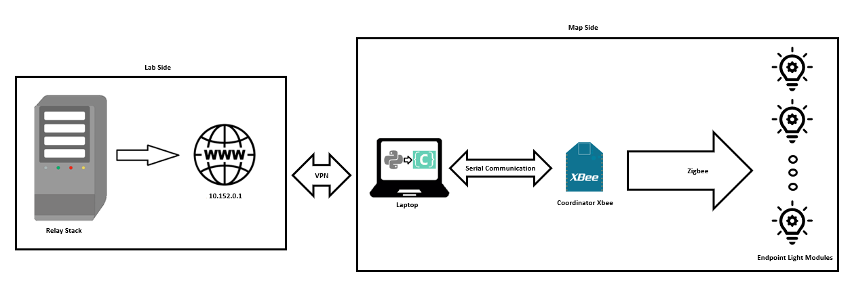
Conceptual Sketch

Slide 6
Technical Challenges
Recharging station
ZigBee vs. RF (Radio Frequency)
Interfacing properly
RF not standardized
Deciding between ZigBee and RF
Cost, quality, comfortability with tech, etc...
ZigBee XTCU HMI software
Not much documentation

Slide 7
Charging Station
Safety is priority
Simple Design
May use wireless charging

Slide 8
The System So Far
Physical wireless prototype with RGB support
Wireless communication between wireless coordinator and light
Serial communication between laptop and wireless coordinator
Laptop can VPN into a server and run a Python script to scrape data off it. Data is publishable onto the server.

Slide 9
Current Prototype
Uses RGB LED in G50 Bulb
Turn light on or off based on simulation component status

Slide 10
Why It's Important
The System is used for community outreach
The system is used for Industry Trainings $$$

Slide 11
Current Status
Relay-to-Server
Server-to-Light
Charging Station
Server exists and can be interfaced with via VPN and scripting.
Server
Have to wait for battery sizing on light modules before we decide how to charge them
Must decide between ZigBee or Radio communication
Need to implement server specific commands
Light modules
Prototyping with both ZigBee and Radio
Can interface between XBee modules using XCTU
Need to integrate relay communication with server communication code

Slide 12
Future
Relay-to-Server
Server
Server-to-Light
Charging Stations
Fully connect in lab
Add more functionality to the existing code
Blocked by light Status
Find proper sized container for module
Decide on a rechargeable battery and magnet
Need to create PCB
Scale to multiple relay boxes
PCB implementation
Make the code more scalable
Begin work on some form of GUI

Slide 13
Questions????

